Slide 1

Getting Started
CSC 4760 / 6760 Big Data Programming
Spring 2018

Slide 2
Open up one of Spark’s shells
Python version of the Spark shell, a.k.a., PySpark shell
In the terminal, type: pyspark
Scala version of the Spark shell
In the terminal, type: spark-shell
Exit either shell: press Ctrl-D or input command : exit()

Slide 3
Create a RDD from a local text file (Python line count)
$ pyspark
>>> lines = sc.textFile(“/home/rob/Assignment1/test.txt") # Create an RDD called lines
>>> lines.count() # Count the number of items in this RDD
3
>>> lines.first() # First item in this RDD, i.e. first line of README.md
u'hadoop spark hadoop'
lines: An RDD

Slide 4
Create a RDD from a local text file (Scala line count)
$ spark-shell
scala> val lines = sc.textFile("/home/rob/Assignment1/test.txt") // Create an RDD called lines
lines: spark.RDD[String] = MappedRDD[...]
scala> lines.count() // Count the number of items in this RDD
res0: Long = 3
scala> lines.first() // First item in this RDD, i.e. first line of README.md
res1: String = hadoop spark hadoop
lines: An RDD

Slide 5
SparkContext Object
Driver programs access Spark through a “SparkContext” object
a “SparkConext” is automatically created for you as the variable called sc
Examining the sc variable
>>> sc
<pyspark.context.SparkContext object at 0x1025b8f90>
>>> sc.textFile() # create an RDD from a text file

Slide 6
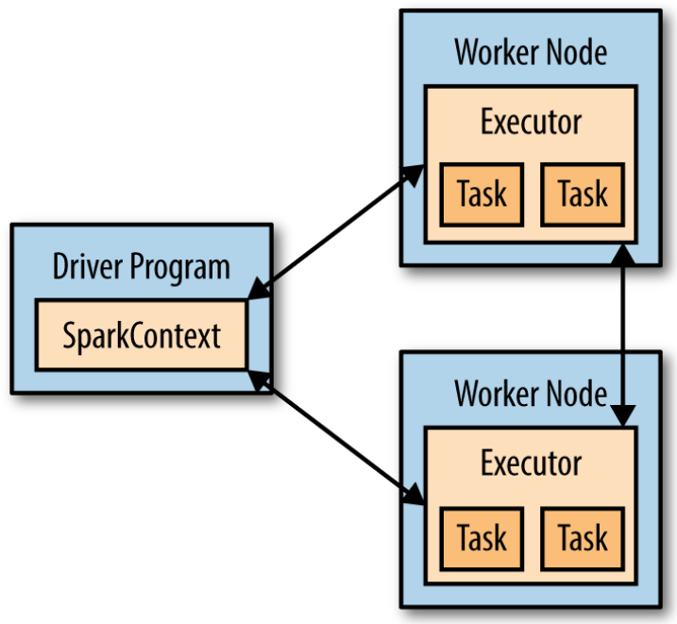
Components for Distributed Execution
Driver programs manage a number of nodes called executors
For example, “lines.count()”
Different machines will count lines in different ranges of the file
If we run the Spark shell locally, it executed all its work on a single machine

Slide 7
Passing Functions to the Spark Operators
lambda: shorthand way to define functions inline in Python
Python – Filtering example
>>> lines = sc.textFile("README.md")
>>> pythonLines = lines.filter(lambda line: "Python" in line)
>>> pythonLines.first()
u'## Interactive Python Shell'
def hasPython(line):
return “Python”in line
>>> pythonLines = lines.filter(hasPython)
>>> pythonLines.first()
u'## Interactive Python Shell'

Slide 8
Passing Functions to the Spark Operators
=> : shorthand way to define functions inline in Scala
Scala – Filtering example
scala> val lines = sc.textFile("README.md") // Create an RDD called lines
lines: spark.RDD[String] = MappedRDD[...]
scala> val pythonLines = lines.filter(line => line.contains("Python"))
pythonLines: spark.RDD[String] = FilteredRDD[...]
scala> pythonLines.first()
res0: String = ## Interactive Python Shell

Slide 9
Passing Functions to the Spark Operators
Java – Filtering example
JavaRDD<String> pythonLines = lines.filter(
new Function<String, Boolean>() {
Boolean call(String line) { return line.contains("Python"); } }
);
Java 8 – Filtering example
-> (lambdas): shorthand way to define functions inline in Java
JavaRDD<String> pythonLines = lines.filter(line -> line.contains("Python"));

Slide 10
Function-based Operations Parallelize across the cluster
Function-based Operations like “filter” also parallelize across the cluster.
Spark automatically takes your function (e.g., line.contains("Python")) and ships it to executor nodes.
You can write code in a single driver program and automatically have parts of it run on multiple nodes

Slide 11
Standalone Applications
Shell | Standalone
SparkContext is created automatically | Initialize your own SparkContext
The process of linking to Spark varies by language
Java, Scala | Python
Maven | bin/spark-submit
bin/spark-submit my_script.py
windows: bin\spark-submit my_script.py

Slide 12
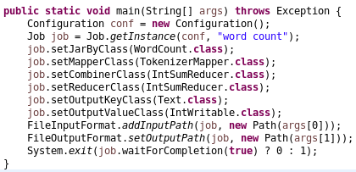
Initializing a SparkContext
Python – Initializing Spark
from pyspark import SparkConf, SparkContext
conf = SparkConf().setMaster("local").setAppName("My App")
sc = SparkContext(conf = conf)
Hadoop Main()

Slide 13
Initializing a SparkContext
Scala – Initializing Spark
import org.apache.spark.SparkConf
import org.apache.spark.SparkContext
import org.apache.spark.SparkContext._
val conf = new SparkConf().setMaster("local").setAppName("My App")
val sc = new SparkContext(conf)
Java – Initializing Spark
import org.apache.spark.SparkConf;
import org.apache.spark.api.java.JavaSparkContext;
SparkConf conf = new SparkConf().setMaster("local").setAppName("My App");
JavaSparkContext sc = new JavaSparkContext(conf);

Slide 14
Initializing a SparkContext
Minimal way to initialize a SparkContext
We pass two parameters:
“local”: a cluster URL. It tells Spark how to connect to a cluster. It runs Spark on one thread on the local machine, without connecting to a cluster
“My App”: An application name. This will identify your application on the cluster manager’s UI if you connect to a cluster.
We will talk about other parameters for configuring how your application executes

Slide 15
Initializing a SparkContext
After the initialization of a SparkContext, you can use all the methods we showed before to create RDDs (e.g., from a text file) and manipulate them
To shutdown Spark,
call Stop() method on your SparkContext
Simply exist the application (e.g., with System.exit(0) or sys.exit())
You should be able to run a standalone Spark application on your laptop

Slide 16
Java
// Create a Java Spark Context
SparkConf conf = new SparkConf().setAppName("wordCount");
JavaSparkContext sc = new JavaSparkContext(conf);
// Load our input data.
JavaRDD<String> input = sc.textFile(inputFile);
// Split up into words.
JavaRDD<String> words = input.flatMap(
new FlatMapFunction<String, String>() {
public Iterable<String> call(String x) {
return Arrays.asList(x.split(" "));
}});
// Transform into pairs and count.
JavaPairRDD<String, Integer> counts = words.mapToPair(
new PairFunction<String, String, Integer>(){
public Tuple2<String, Integer> call(String x){
return new Tuple2(x, 1);
}}).reduceByKey(new Function2<Integer, Integer, Integer>(){
public Integer call(Integer x, Integer y){ return x + y;}});
// Save the word count back out to a text file, causing evaluation.
counts.saveAsTextFile(outputFile);
Word Count

Slide 17
Scala
Word Count
// Create a Scala Spark Context.
val conf = new SparkConf().setAppName("wordCount")
val sc = new SparkContext(conf)
// Load our input data.
val input = sc.textFile(inputFile)
// Split it up into words.
val words = input.flatMap(line => line.split(" "))
// Transform into pairs and count.
val counts = words.map(word => (word, 1)).reduceByKey{case (x, y) => x + y}
// Save the word count back out to a text file, causing evaluation.
counts.saveAsTextFile(outputFile)

Slide 18
sbt build file
name := "learning-spark-mini-example"
version := "0.0.1"
scalaVersion := "2.10.4"
// additional libraries
libraryDependencies ++= Seq(
"org.apache.spark" %% "spark-core" % "1.3.0" % "provided"
)

Slide 19
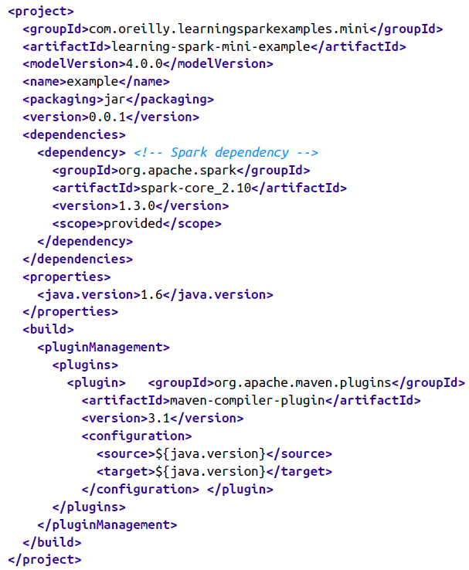
Maven build file - part 1

Slide 20
Maven build file - part 2

Slide 21
Scala build and run
sbt clean package
$SPARK_HOME/bin/spark-submit \
--class com.oreilly.learningsparkexamples.mini.scala.WordCount \
./target/...(as above) \
./README.md ./wordcounts

Slide 22
Maven build and run
mvn clean && mvn compile && mvn package
$SPARK_HOME/bin/spark-submit \
--class com.oreilly.learningsparkexamples.mini.java.WordCount \
./target/learning-spark-mini-example-0.0.1.jar \
./README.md ./wordcounts

